Slide 1
GACP Assignment
By Nathan Bailey

Slide 2
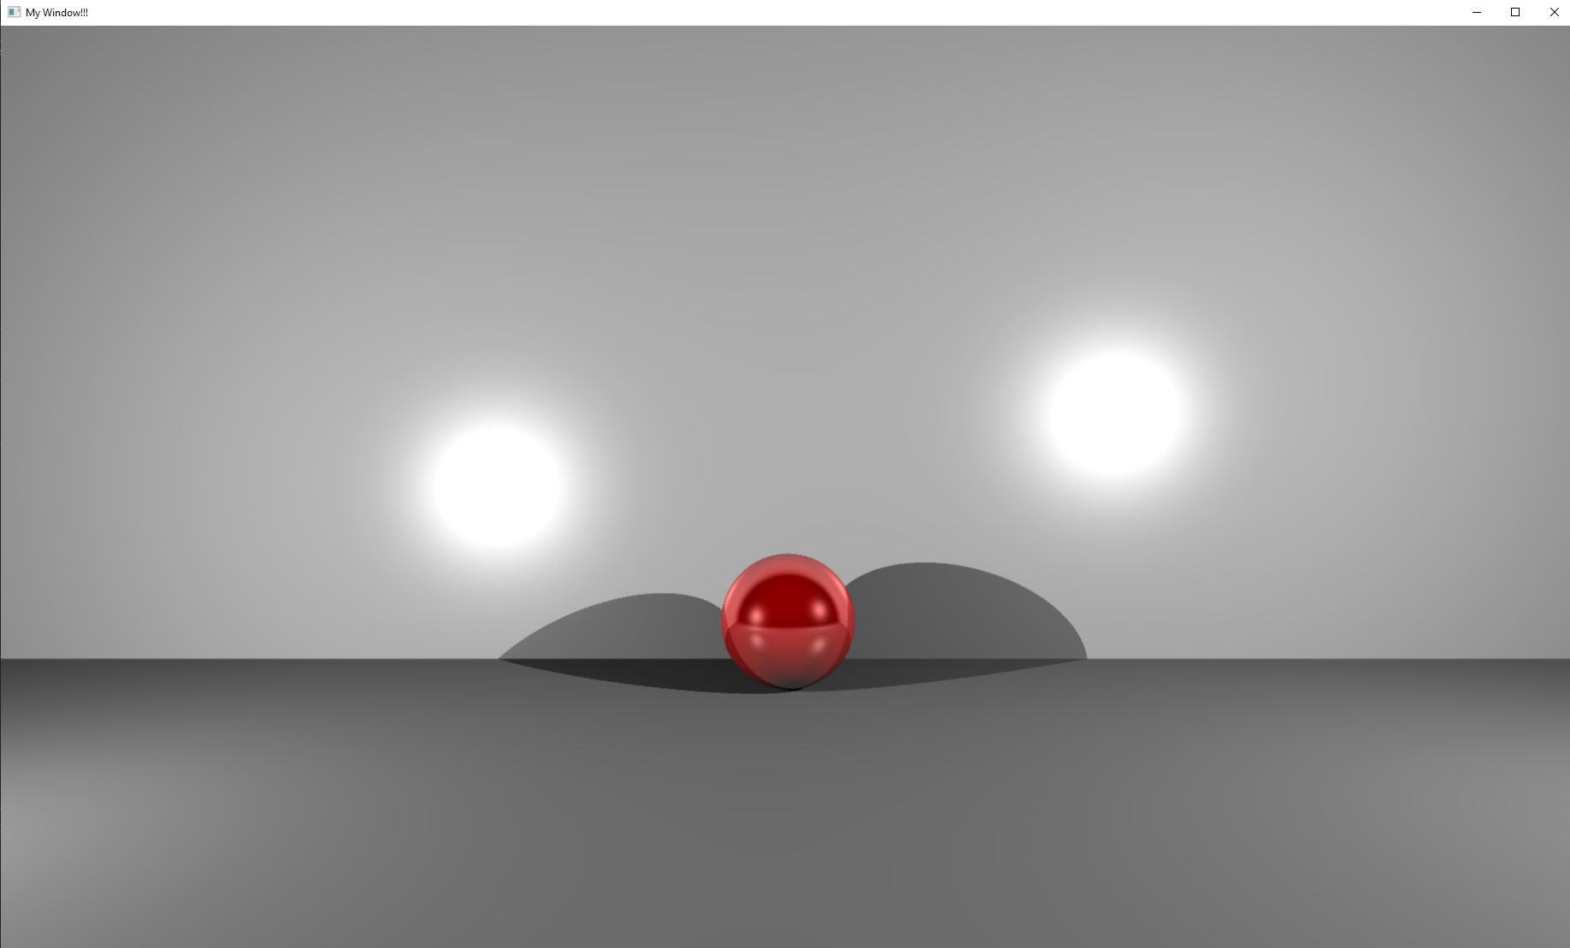
Overview
Theory
Design
Demo
Analysis
Evaluation

Slide 3
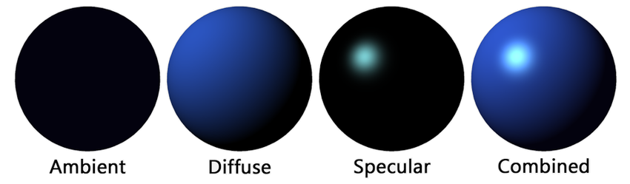
Phong Reflection Model
I use the Phong Reflection Model as a base.
I combine each layer to output the final colour.
Notes:
Image: https://www.researchgate.net/figure/The-components-of-the-Phong-illumination-model_fig4_370763969

Slide 4
Phong Reflection Model
I use the Phong Reflection Model as a base.
I combine each layer to output the final colour.
Notes:
Image: https://www.researchgate.net/figure/The-components-of-the-Phong-illumination-model_fig4_370763969

Slide 5
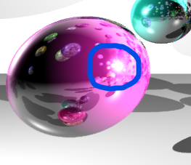
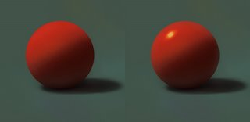
Specular
Specular lighting is the bright spot on a shiny object which is created when a light shines on the shiny surface
Notes:
Bottom left image: https://www.samnielson.com/artsammich/2006/08/tip-of-week-matte-and-specular.html
Bottom right image: My own work https://github.com/iceboundworm8111/NB-Raytracer

Slide 6
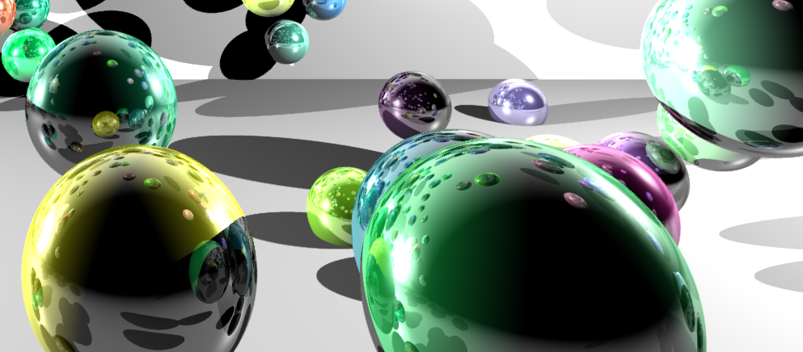
Reflections
Equation to calculate reflection direction: R=D−2(D⋅N)N
R = Reflection Directions
D = Initial Ray Direction
N = Normal

Slide 7

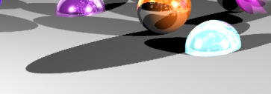
Anti-Aliasing
Shoot multiple rays per ray to get an average colour
1x Anti-Aliasing
8x Anti-Aliasing

Slide 8
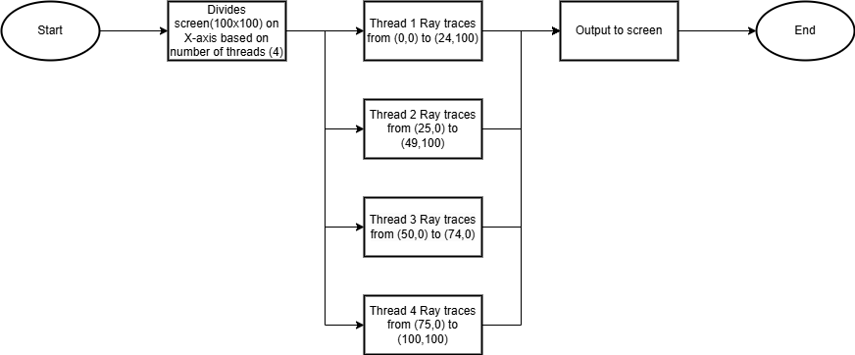
Design - Multithreading

Slide 9
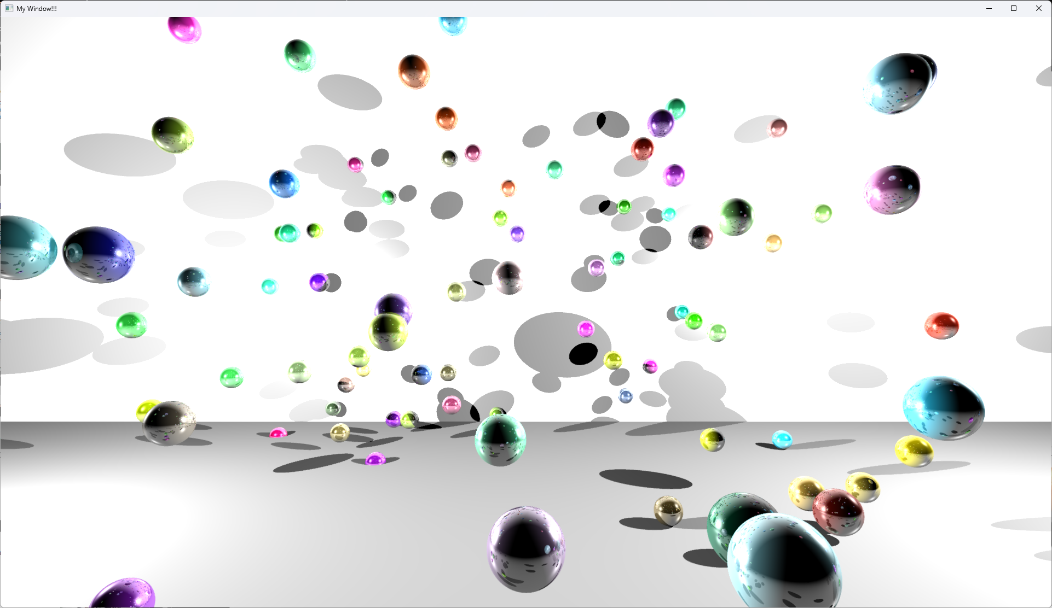
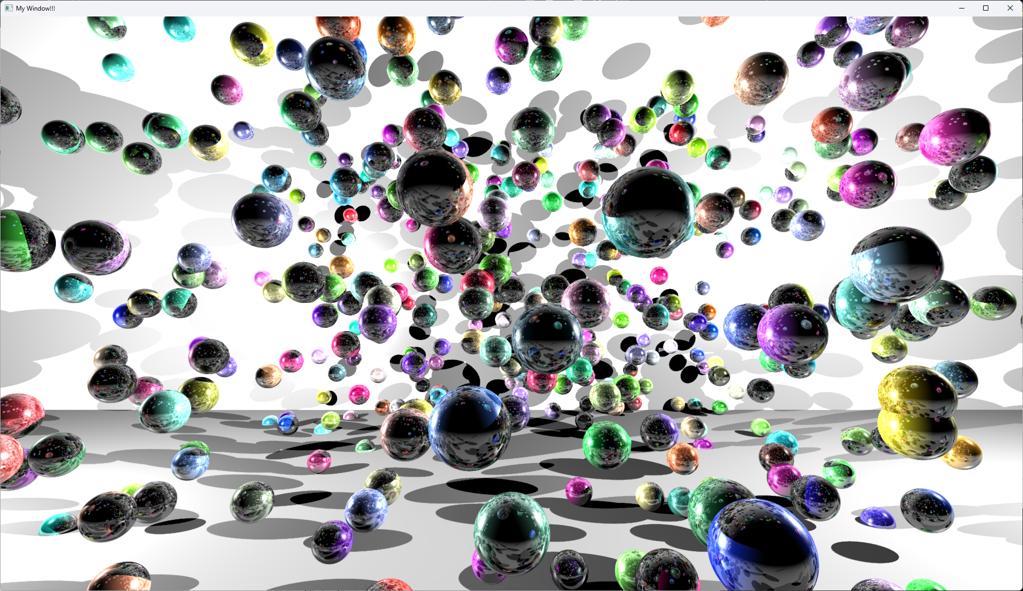
Demo (all images were screenshotted with a resolution of 1920x1080)
100 Spheres, radius:1, reflection depth:3, colour: random
500 Spheres, radius:1, reflection depth:3, colour: random

Slide 10
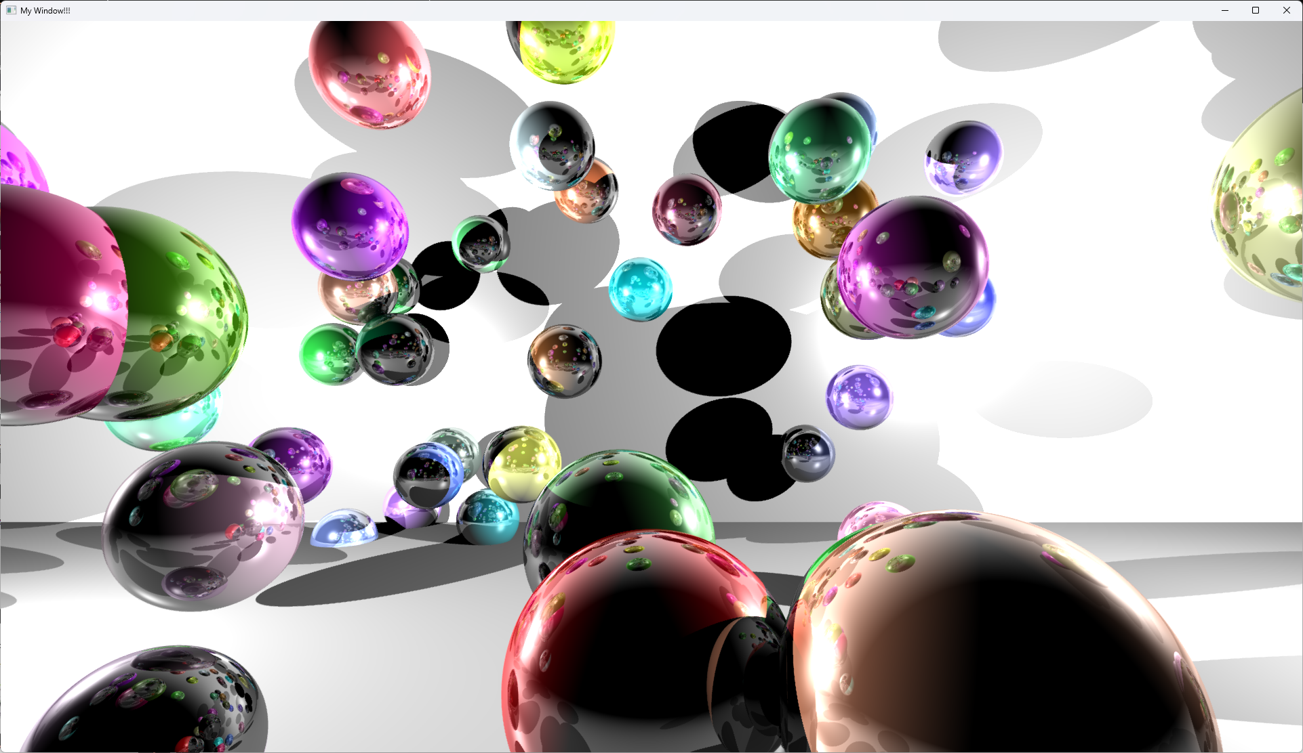
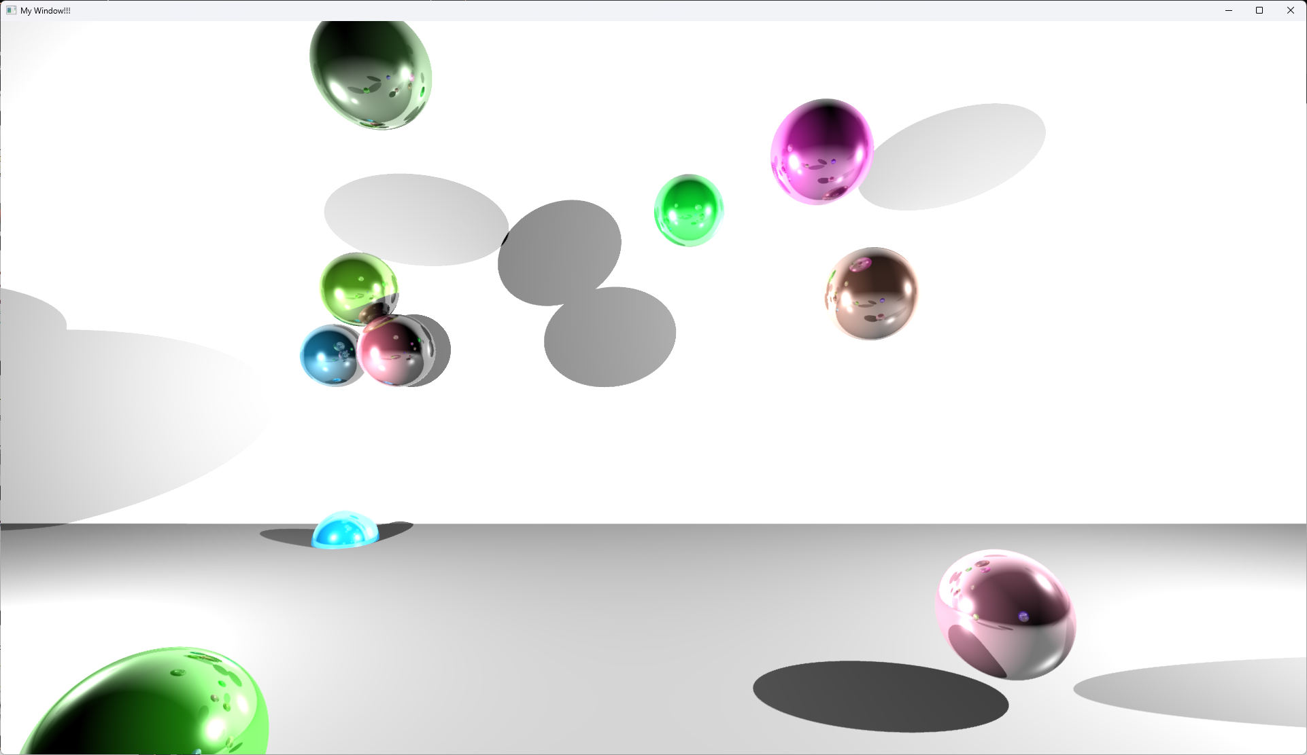
Demo (all images were screenshotted with a resolution of 1920x1080, Anti-Aliasing 8x)
50 Spheres, radius:3, reflection depth:3, colour: random
10 Spheres, radius:3, reflection depth:3, colour: random

Slide 11
Quantitative analysis

Slide 12
Quantitative analysis

Slide 13

Qualitative Analysis
My raytracer
My Blender Render

Slide 14
Qualitative Analysis

Slide 15
Qualitative Analysis
My raytracer
My Blender Render

Slide 16
Overall
My raytracer is parallel programmed
Anti-Aliasing, Reflections, Shadows, Specular
However
GPU is much quicker
Only made Anti-Aliasing up to 8x

Slide 17
References
https://murf.ai/studio/project/2/P0173435172108250N?workspaceId=WORKSPACEID017343517203833JK

